Slide 1

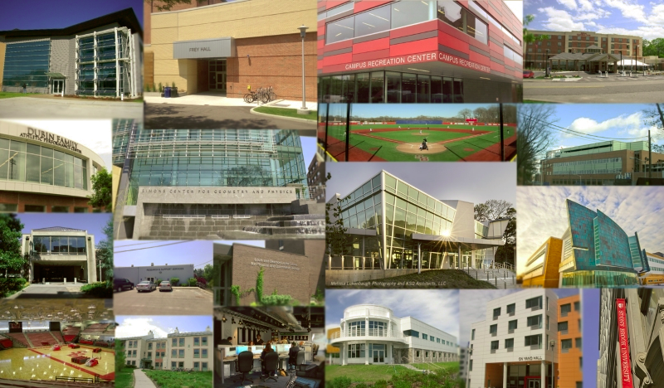

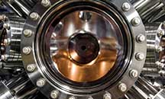


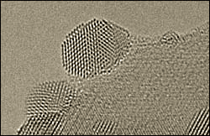
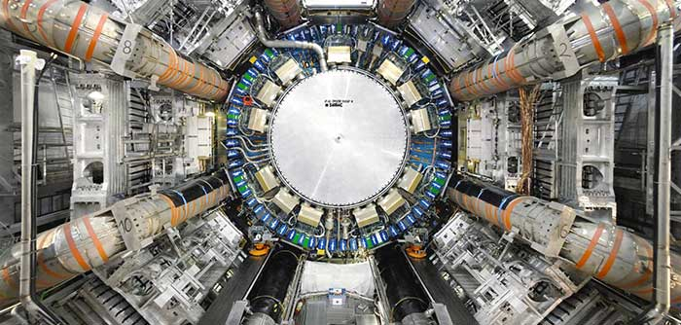
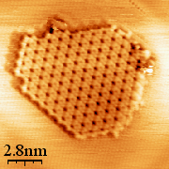
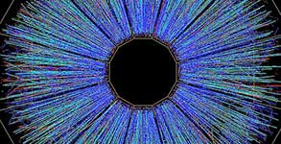
Ex-situ Raman studies for H-ZSM-5 and Mo/ZSM-5 materials
Fundamental Studies of TMO_{x}/BNNT catalysts on CO oxidation
Krishna Kumari, Aldo Bushati, and Taejin Kim
Materials Science and Chemical Engineering Department,
Stony Brook University, Stony Brook, NY, USA
Jinwon Choi and Taejin Kim
Materials Science and Chemical Engineering Department,
Stony Brook University, Stony Brook, NY, USA
A Passion for Discovery
Notes:
Introduce yourself

Slide 2
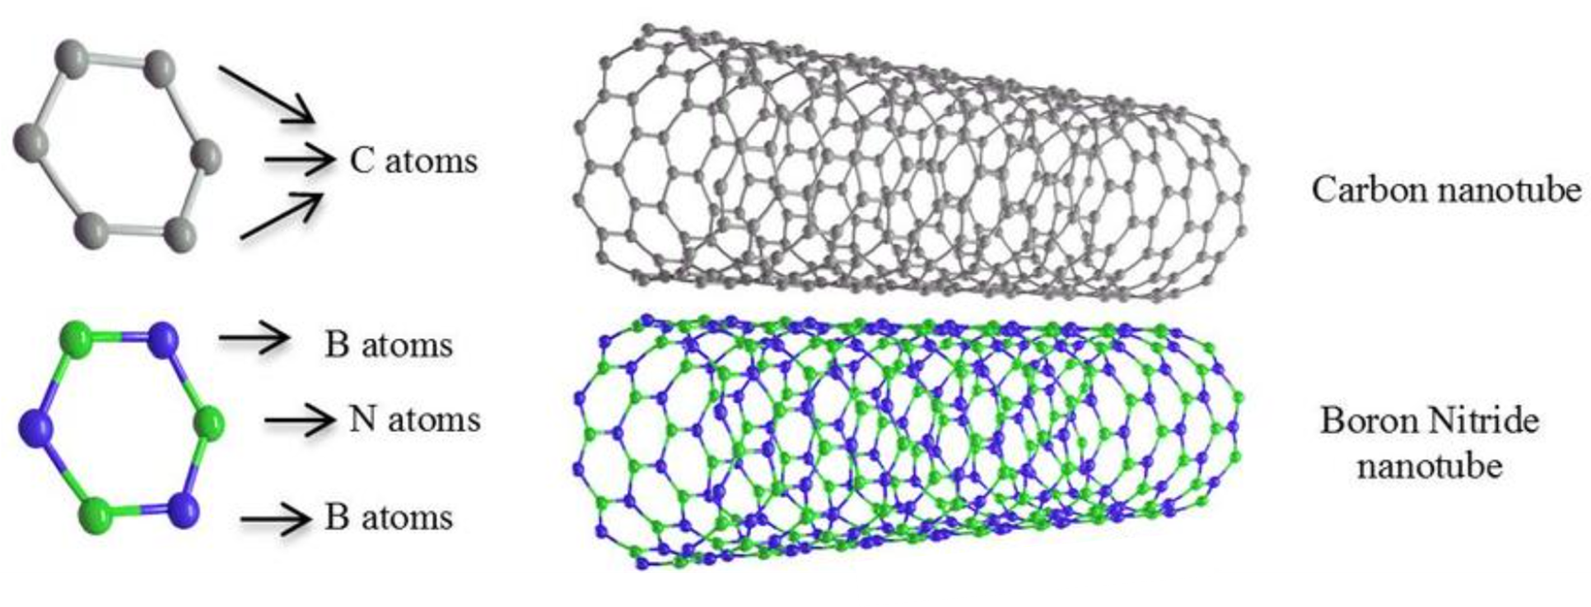
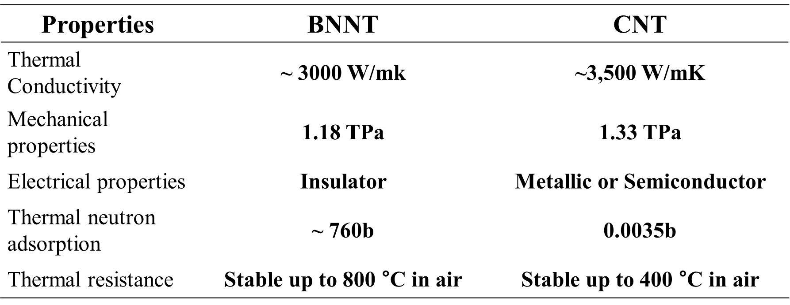

BNNT properties compared with CNT
Boron Nitride Nanotubes (BNNTs) are a type of nanomaterial that share structural similarities with carbon nanotubes (CNTs) but are composed of boron (B) and nitrogen (N) atoms rather than carbon atoms.

Slide 3
Research objectives:
Ⅰ. Designing transition metal oxide catalyst supported on BNNT.
Ⅱ. Investigation of the physical properties and catalytic characterization of synthesized catalysts for CO oxidation.
Ⅲ. Understanding the relationship between their physicochemical properties and catalytic performance

Slide 4
Experiments
Sample information
- 3 wt% TMO_{x}/BNNT
Transition Metal: Fe, Co, Ni, Cu
Synthesis procedures:
Premixing step: Premixing samples using a mortar and pestle for 20 min
Evaporation step: N₂(UHP, 20 ml/min) at 170℃ for 2 hr
Calcination step: Dry air(20 ml/min) at 400℃ for 4 hr

Slide 5
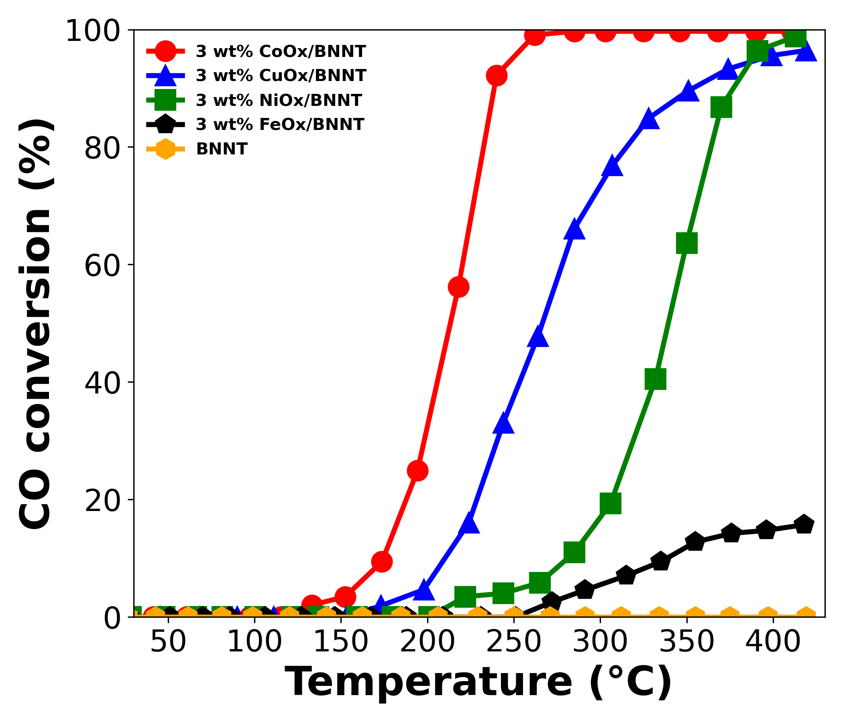
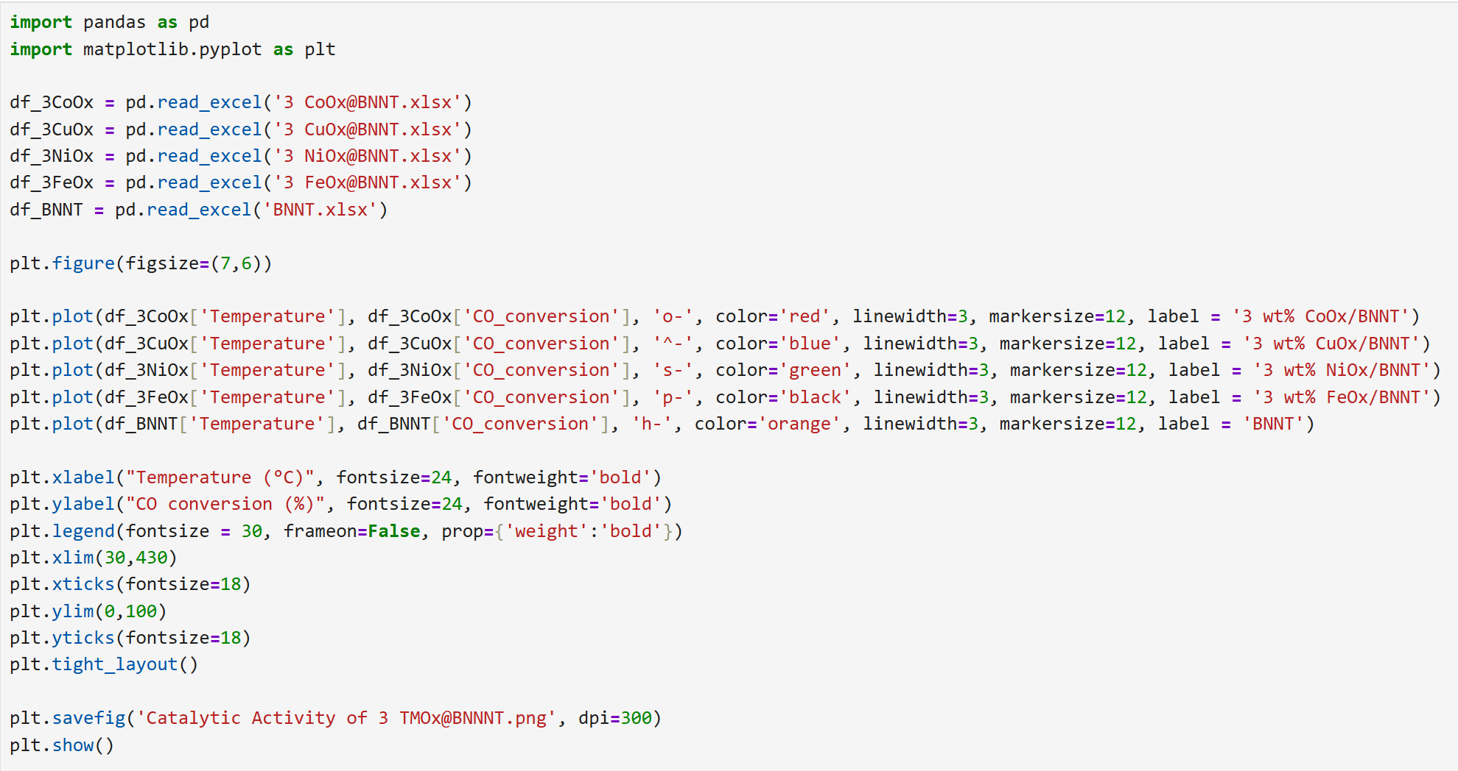
Catalytic Performance for CO oxidation
Experiment conditions: 20 ml/min CO (10% CO balance with He), 10 ml/min O2, and 20 ml/min He. Gas composition: 4 vol% CO, 20 vol% O2, 76 vol% He.
Catalytic performance
3 wt% MOx/BNNT: 3 wt% CoOx/BNNT > 3 wt% CuOx/BNNT > 3 wt% NiOx/BNNT > 3 wt% FeOx/BNNT

Slide 6
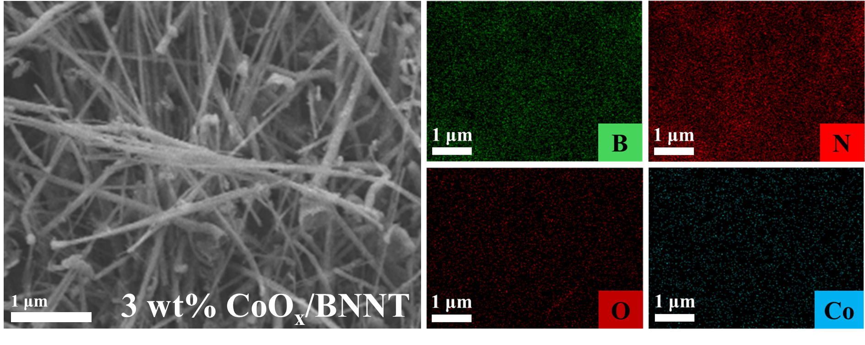
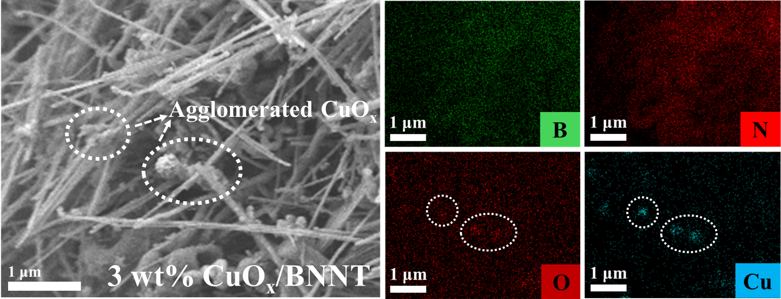
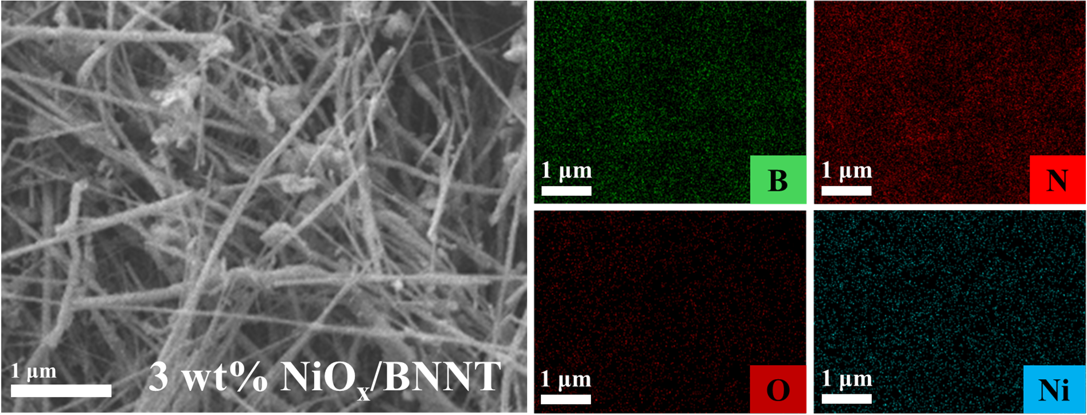
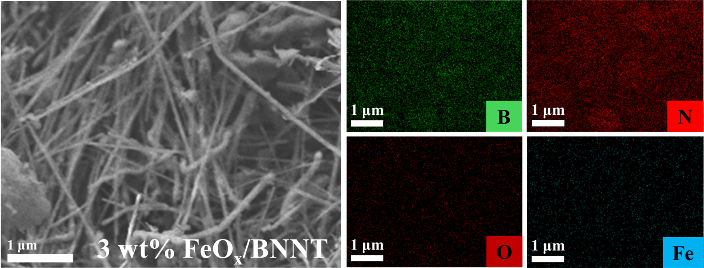
SEM-EDX Results
3 wt% MOx/BNNT Catalysts (M=Co, Cu, Ni, Fe)
Metal oxide (e.g., CoOx, NiOx, FeOx) is well dispersed in each 3 wt% MOx/BNNT catalyst.
However, the 3 wt% CuOx/BNNT shows some agglomerations composed of CuOx species.
6

Slide 7
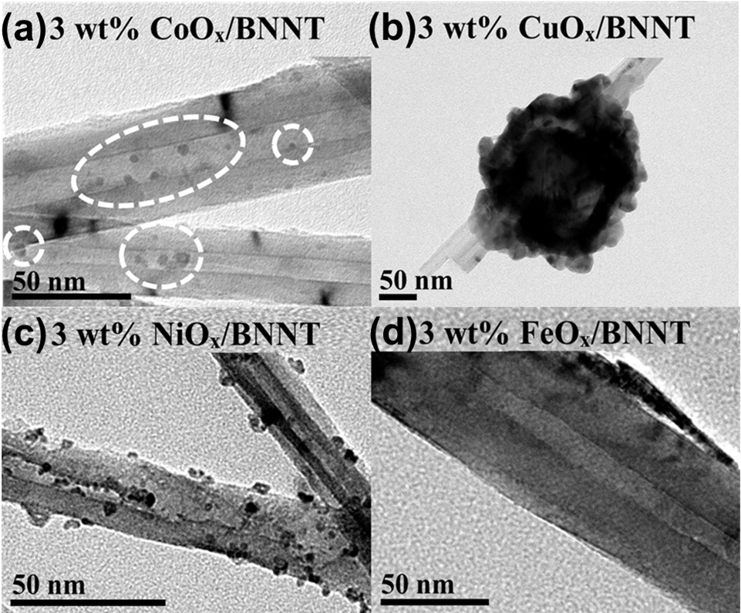
TEM Results
Metal size and dispersion are significantly different depending on MOx/BNNT catalysts.
In the case of the 3 wt% FeOx/BNNT, finding metal was quite difficult.
The presence of the CoOx species was increased with increasing metal loading.
7

Slide 8
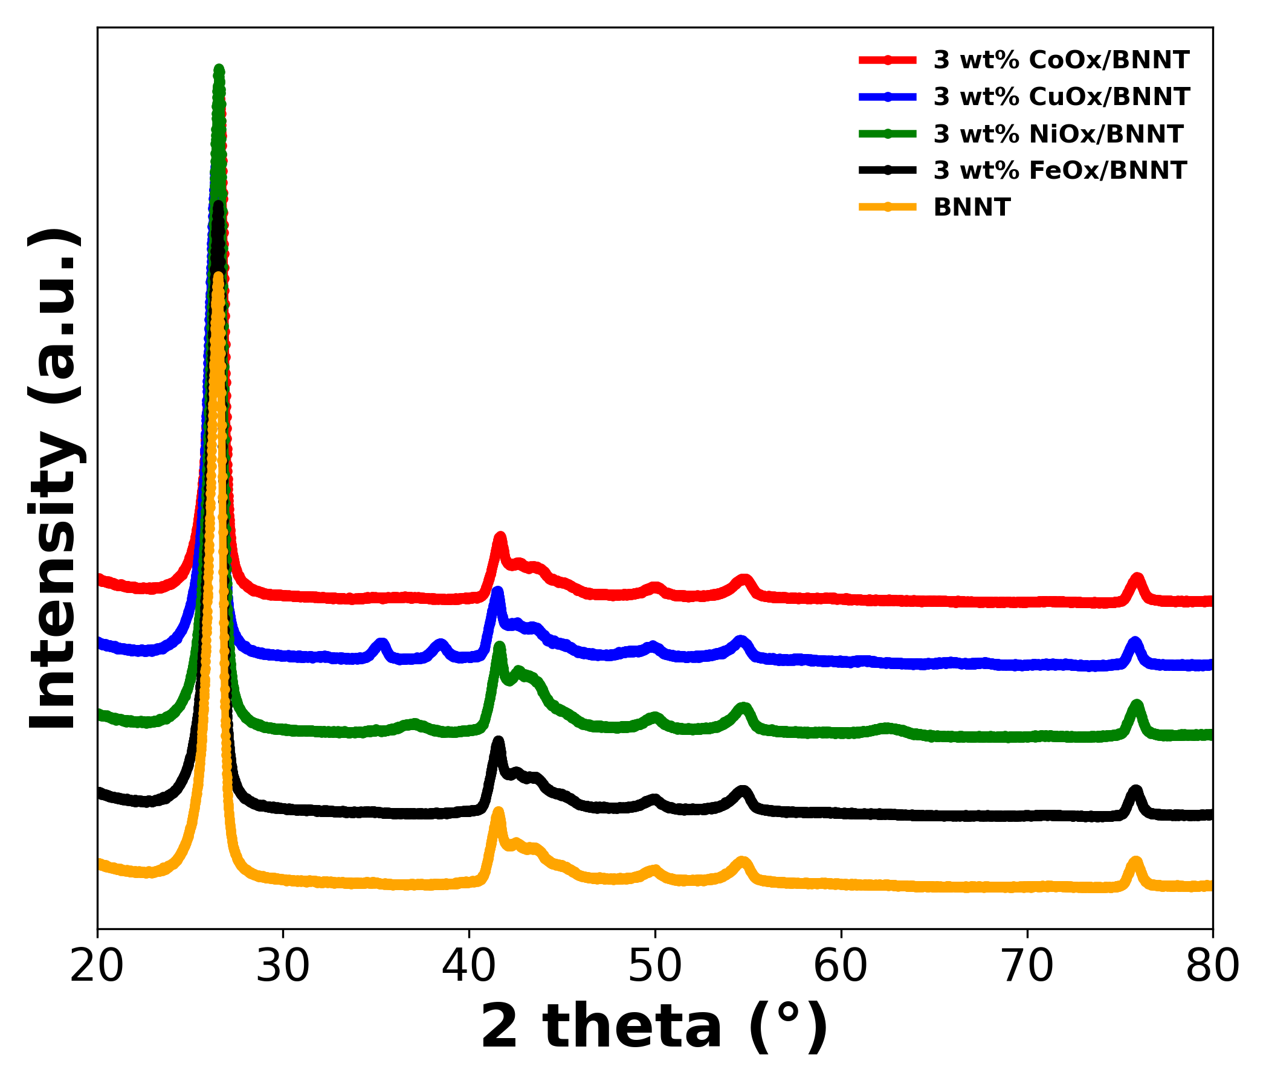
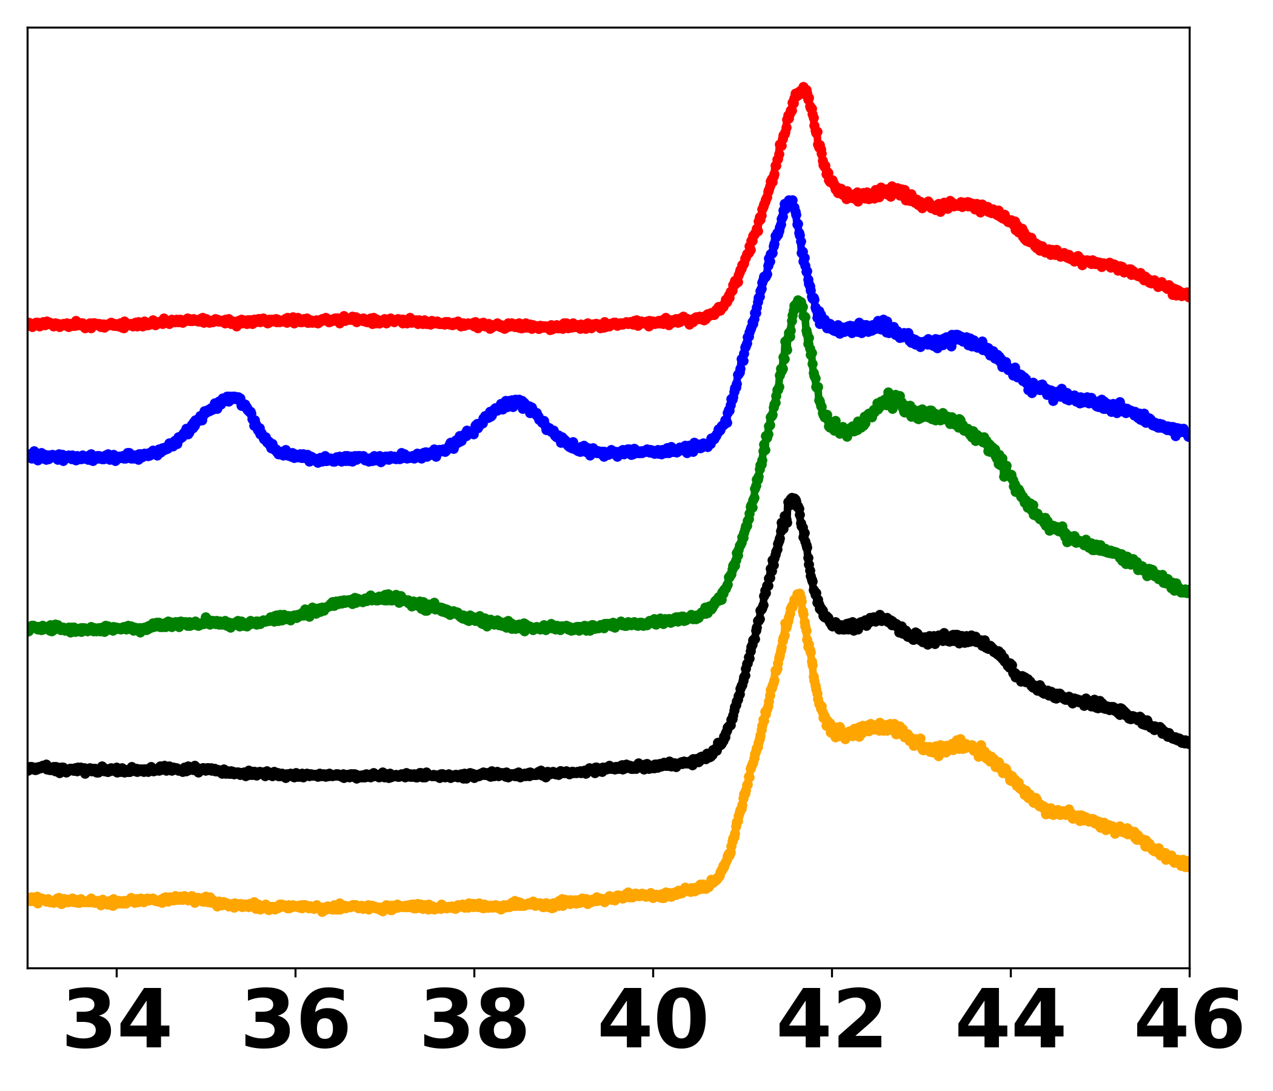
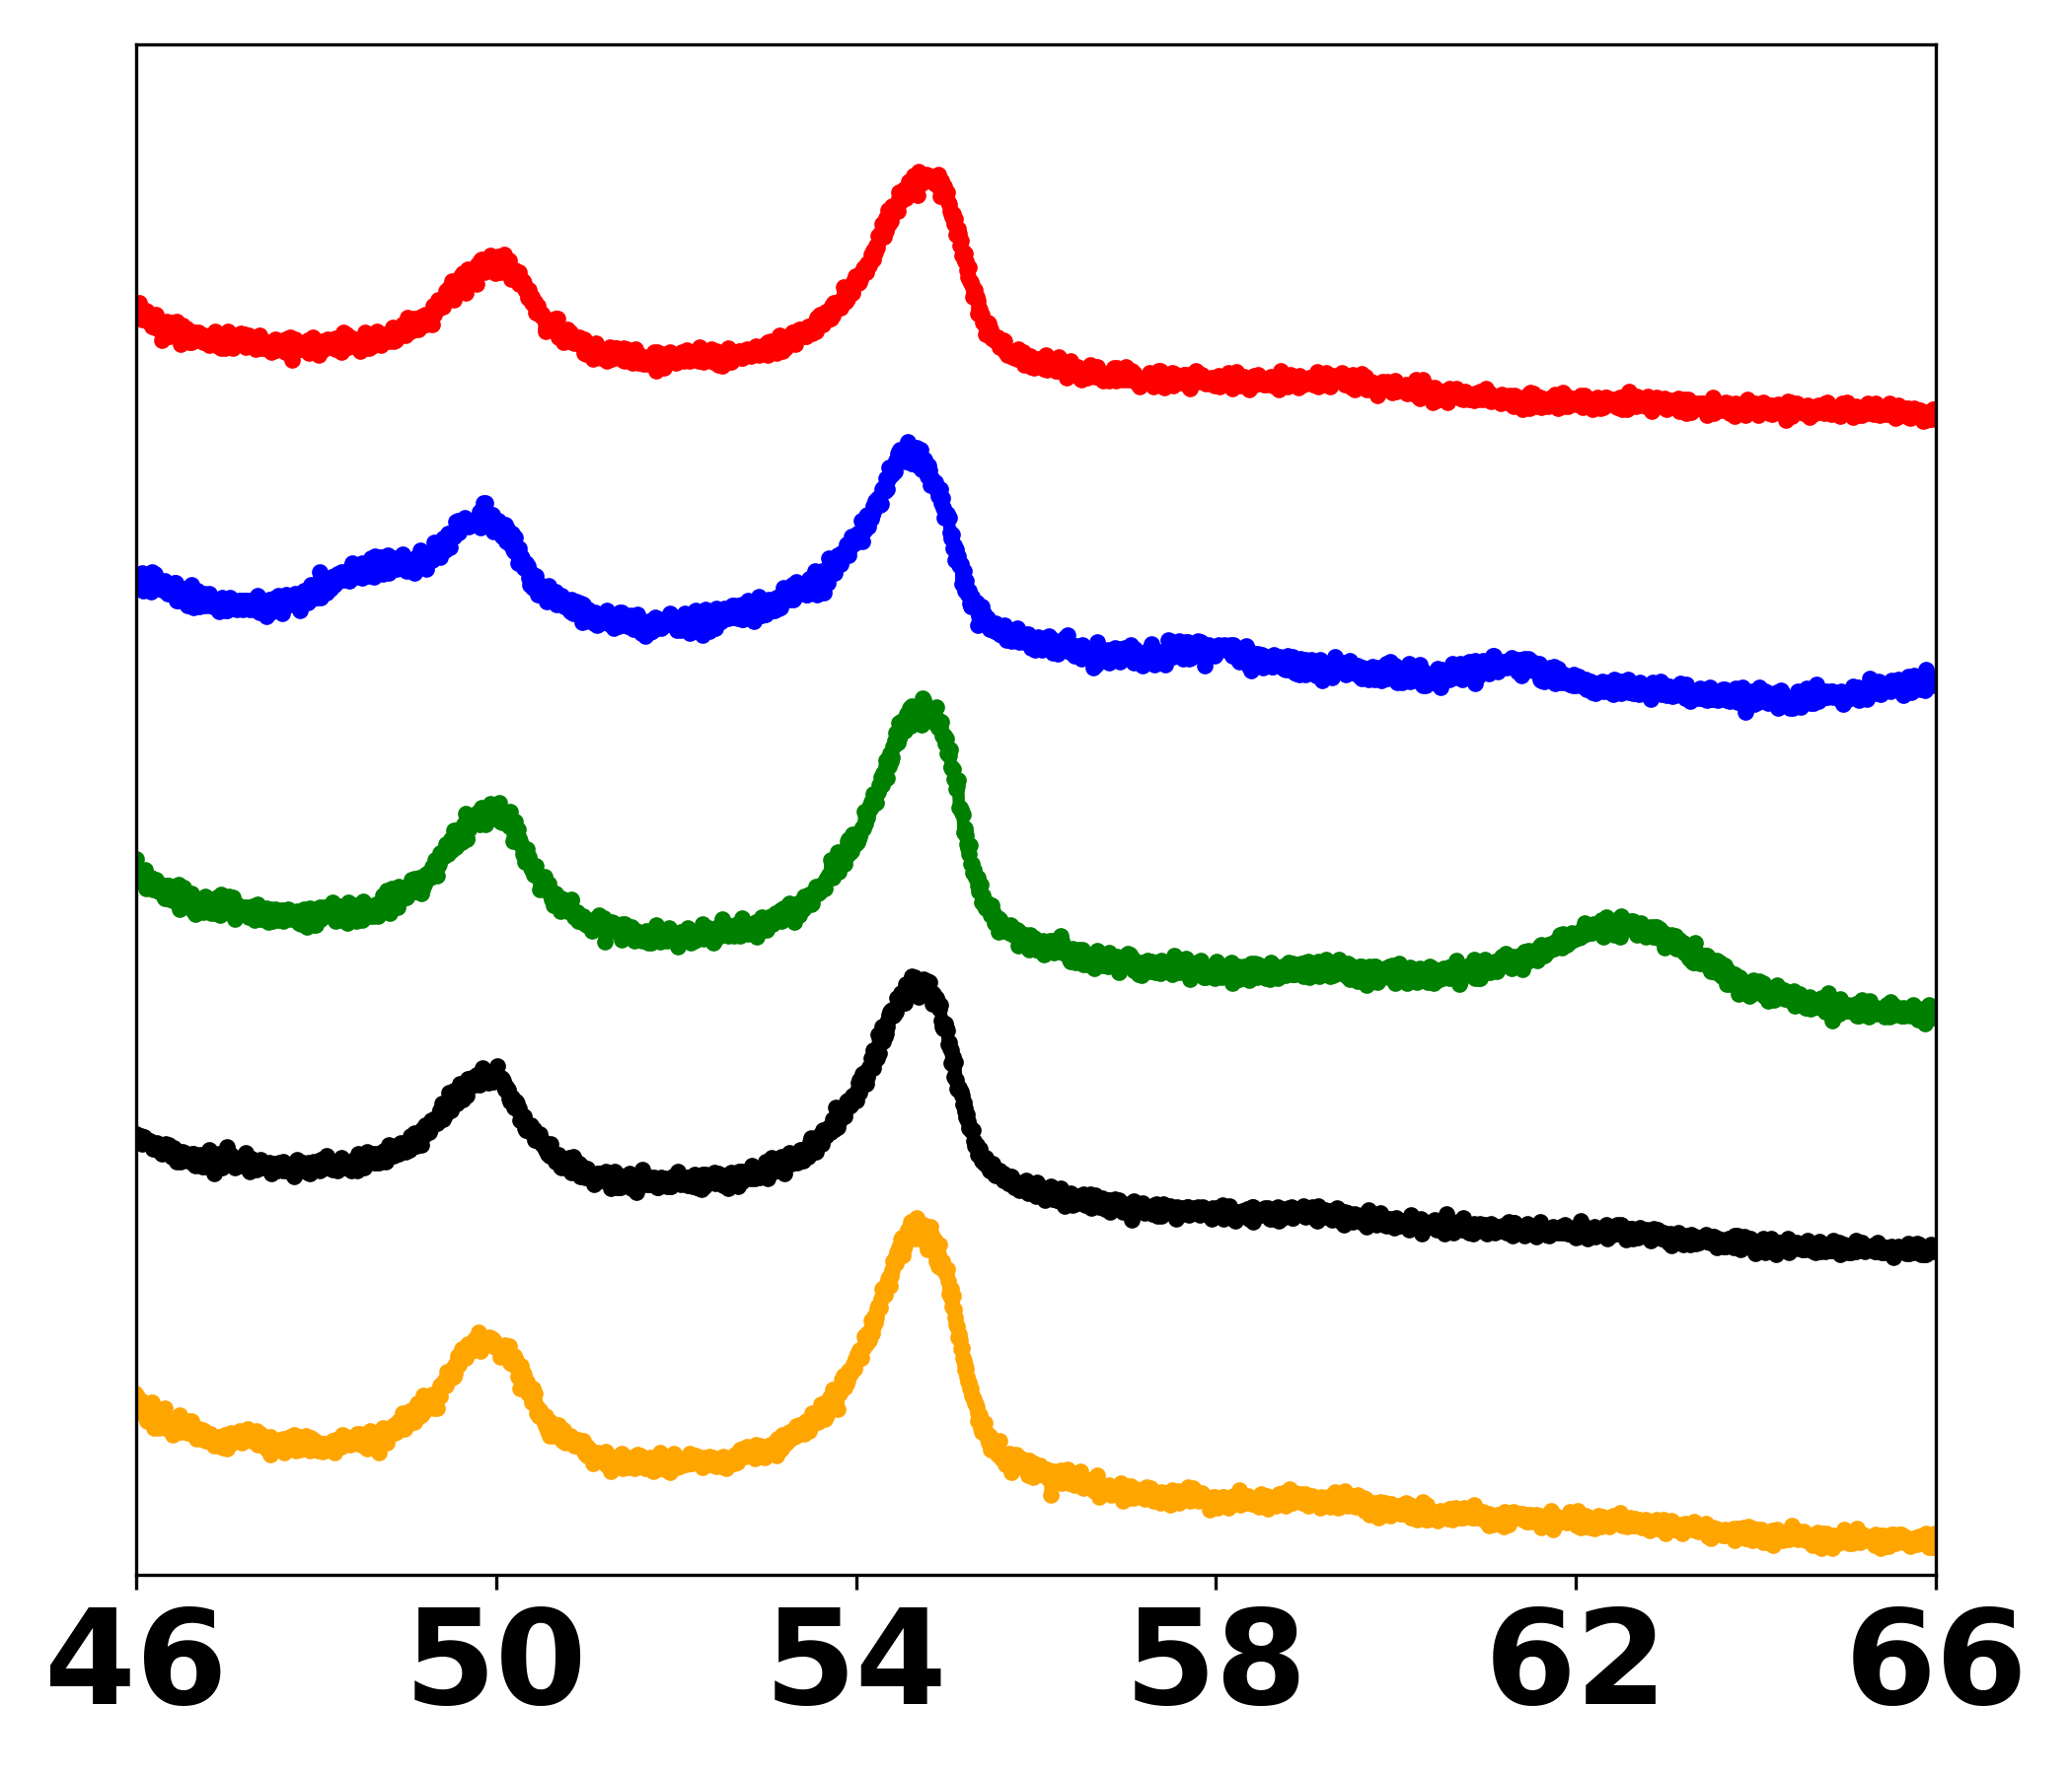
XRD results-3 wt% MOx/BNNT
CuO
NiO
A1
(002)
A2
A1
(100)
(102)
(004)
(110)
A2
3 wt% CuOx/BNNT and NiOx/BNNT showed distinct surface species peaks, while 3 wt% CoOx/BNNT and FeOx/BNNT did not.
8

Slide 9
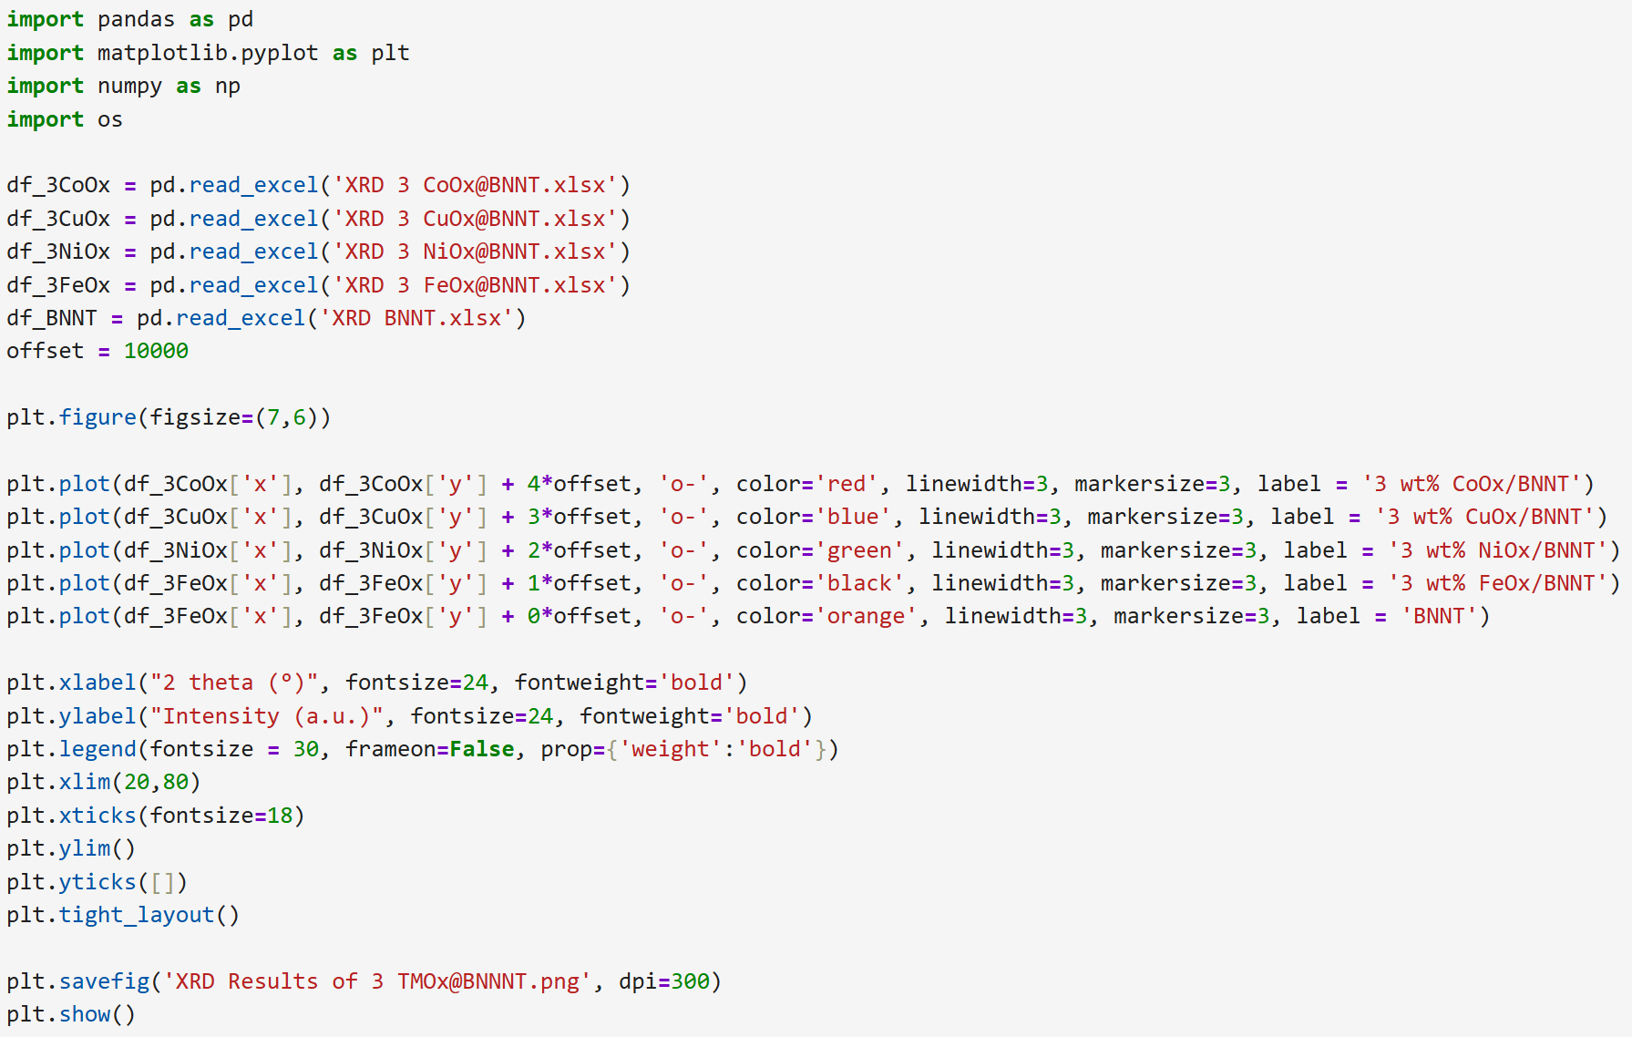
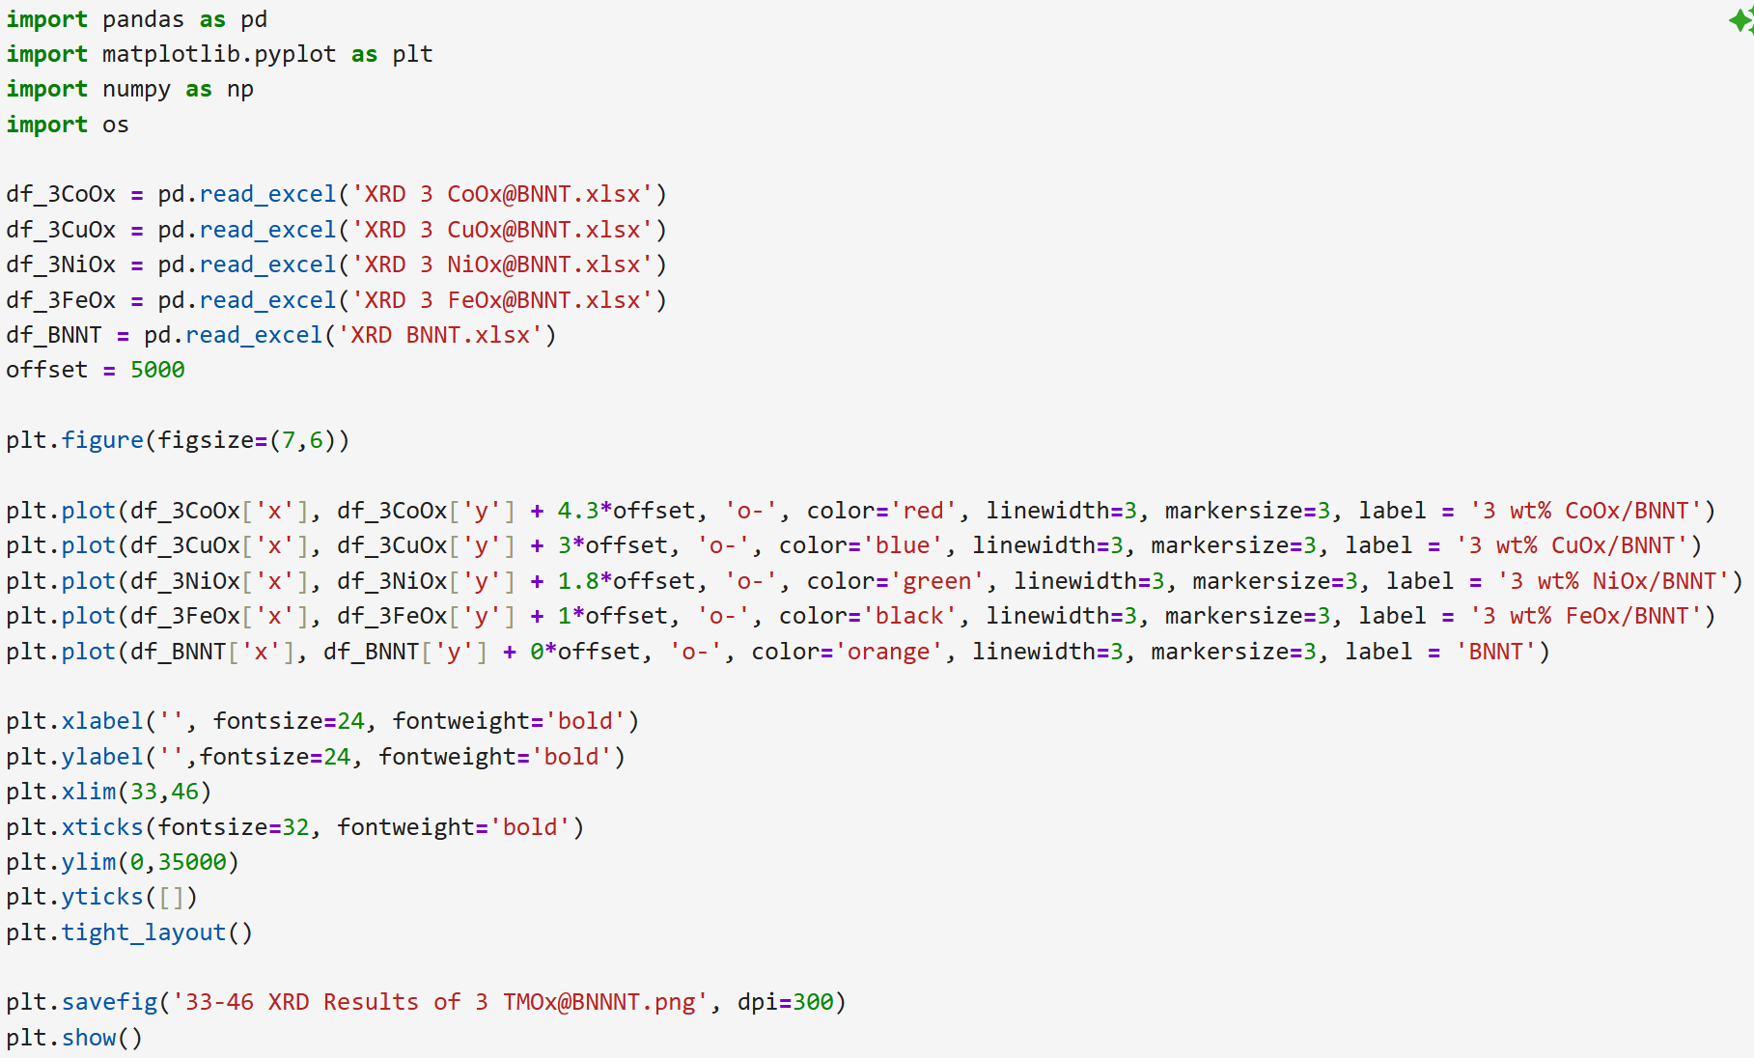
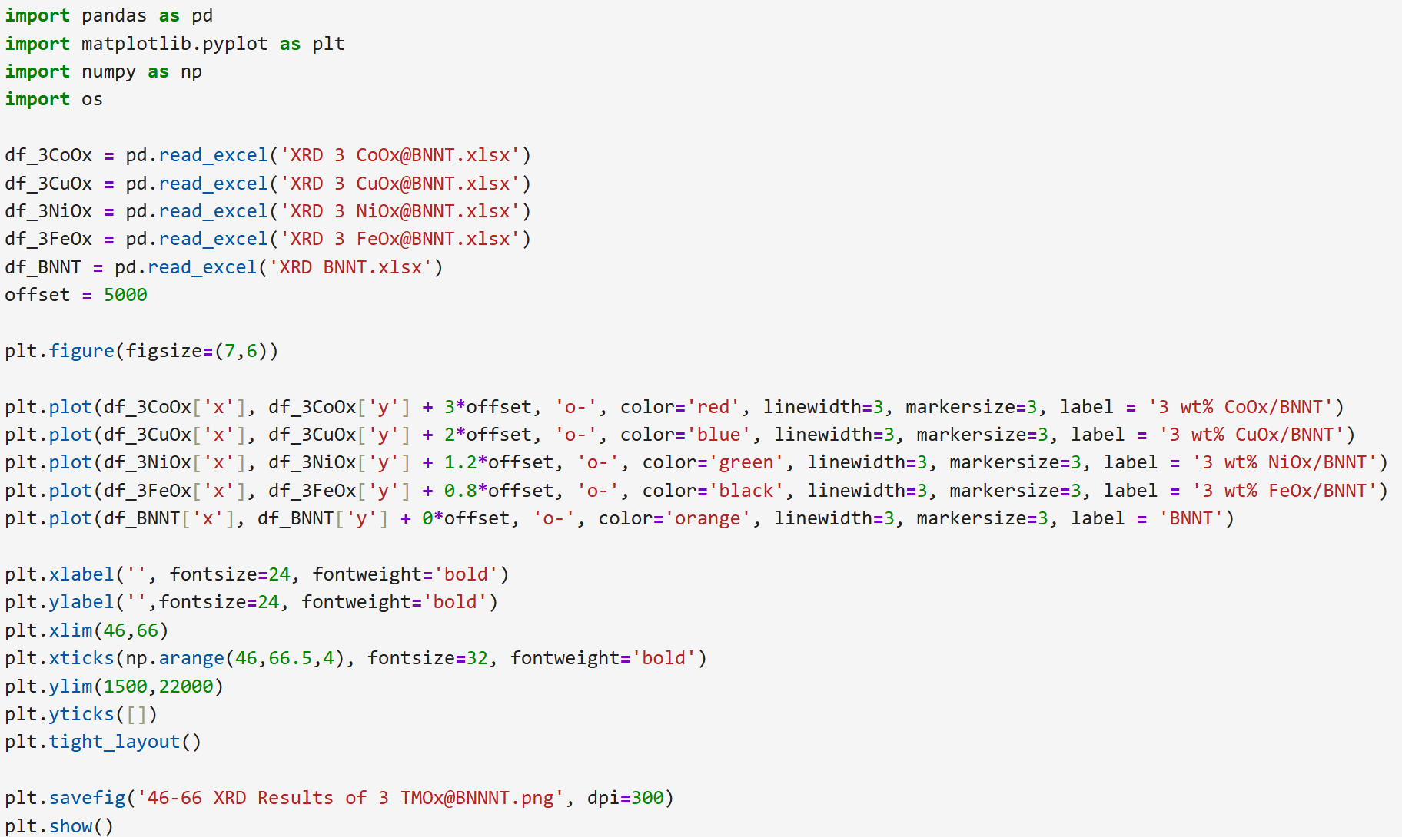
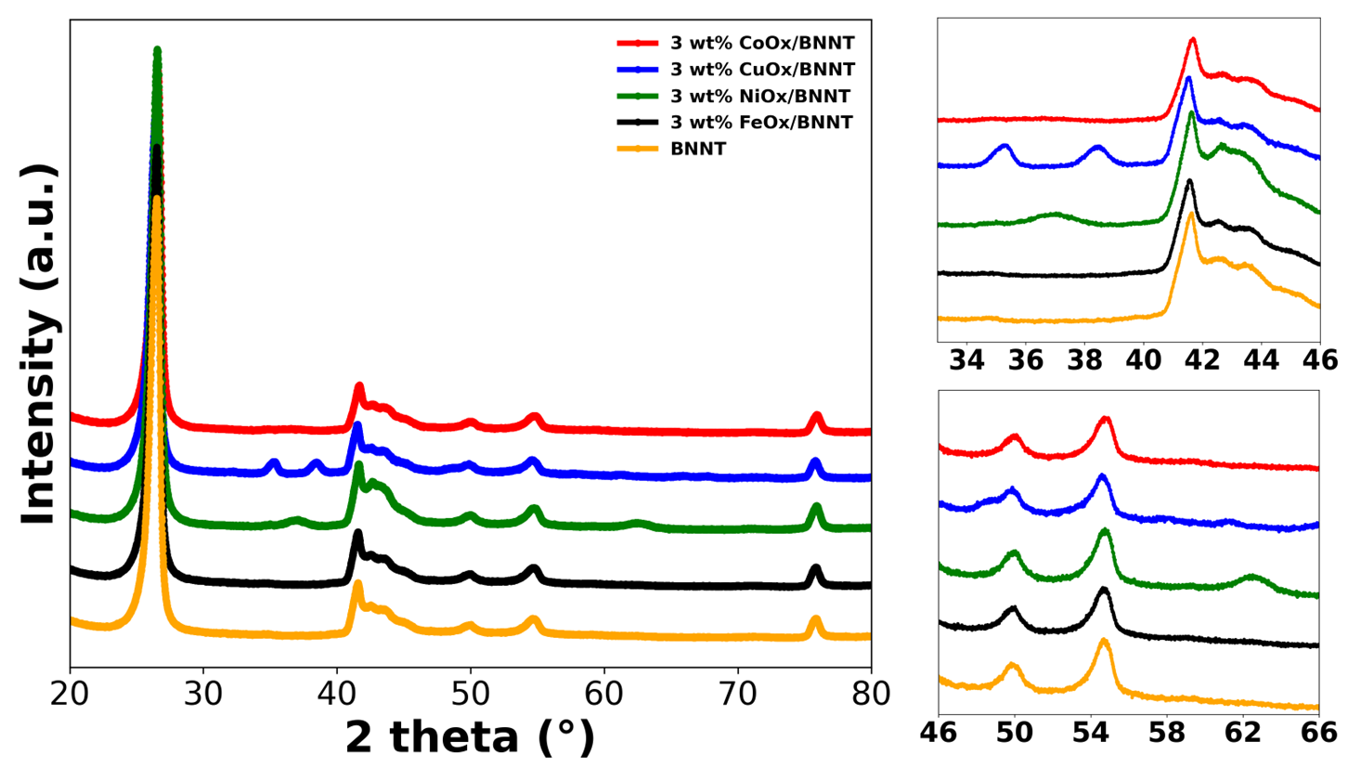

Slide 10
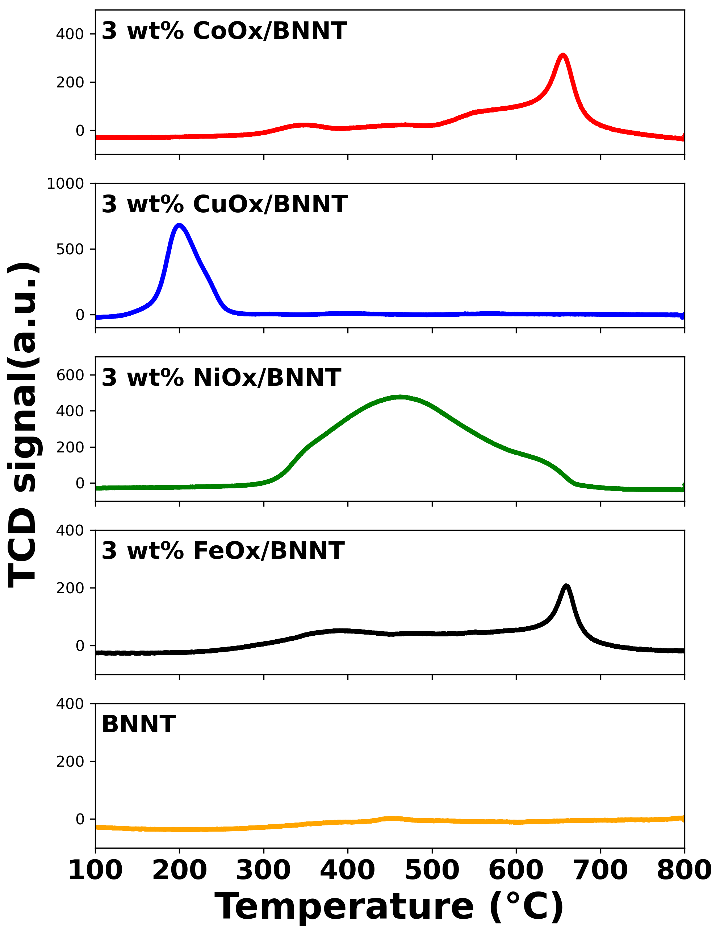
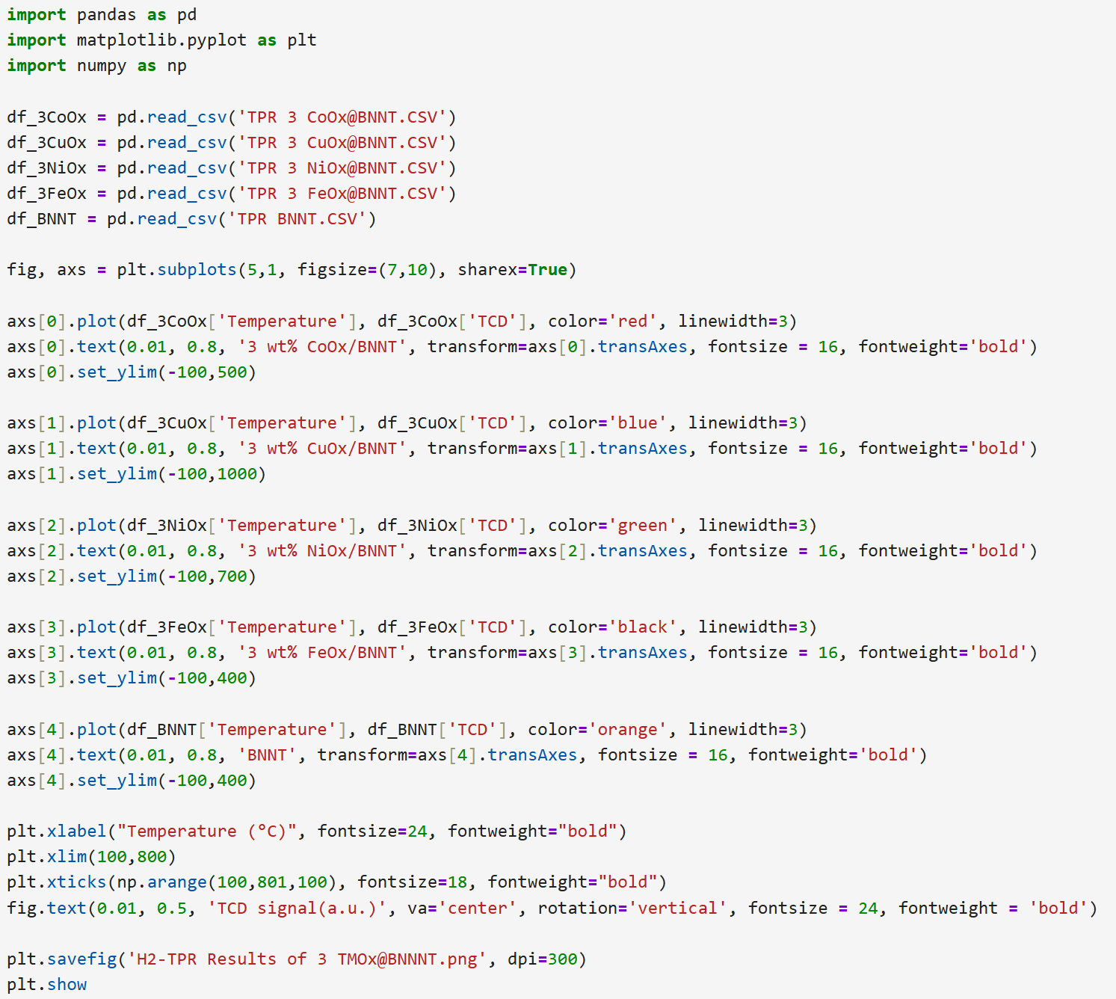
TPR results- 3 wt% MOx/BNNT and x wt% CoOx/BNNT

Slide 11
Conclusion and future works
Conclusion
Successfully synthesized 3 wt% MOₓ/BNNT catalysts (M = Co, Cu, Ni, Fe).
CoOx/BNNT showed the highest catalytic performance for CO oxidation.
CuOx/BNNT exhibited agglomeration.
Python was effectively used for data handling and multi-plot generation.
Future Works
Expand Python usage: calculating the average particle size, crystalline size, and data smoothing.

Slide 12
Python code description
Import | Description
import pandas as pd | Load and manipulate structured data.
import matplotlib.pyplot as plt | Create and customize plots and graphs.
import numpy as np | Perform numerical operations and create numerical arrays.
import os | Interact with the operating system.
pandas.read_excel() | Load data from Excel files.
offset variable | Add vertical offset to each spectrum to avoid overlapping lines.
matplotlib.pyplot.plot() | Plot data for different catalysts with offset stacking.
plt.xlabel(), plt.ylabel() | Label X and Y axes; Y-ticks are hidden for clarity.
plt.legend() | Add a legend to identify each spectrum.
plt.xlim(a,b) | Set X-axis range from a to b.
plt.tight_layout() | Ensure clean arrangement of labels and plots.
plt.savefig() | Save the figure as a PNG file.
plt.show() | Display the created figure.
plt.subplots(5,1, sharex=True) | Create 5 vertically stacked subplots sharing a common X-axis.
axs[i].plot() | Plot the data for each catalyst in its own subplot.
axs[i].text() | Insert sample name inside each subplot at a fixed position.
axs[i].set_ylim() | Manually adjust Y-axis limits for each sample for better comparison.

Slide 13
Ex-situ Raman studies for H-ZSM-5 and Mo/ZSM-5 materials
Thank you
Krishna Kumari, Aldo Bushati, and Taejin Kim
Materials Science and Chemical Engineering Department,
Stony Brook University, Stony Brook, NY, USA
A Passion for Discovery
Notes:
Introduce yourself

